Slide 1



Main Title
Subheading or date

Slide 2

Slide Heading – STT campus background
Body Text – Adjust line spacing and text size based on the amount of content inserted here. Body Text – Adjust line spacing and text size based on the amount of content inserted here.
Body Text – Adjust line spacing and text size based on the amount of content inserted here.
Body Text – Adjust line spacing and text size based on the amount of content inserted here.
Body Text – Adjust line spacing and text size based on the amount of content inserted here.
Body Text – Adjust line spacing and text size based on the amount of content inserted here.
Body Text – Adjust line spacing and text size based on the amount of content inserted here.
Body Text – Adjust line spacing and text size based on the amount of content inserted here.

Slide 3
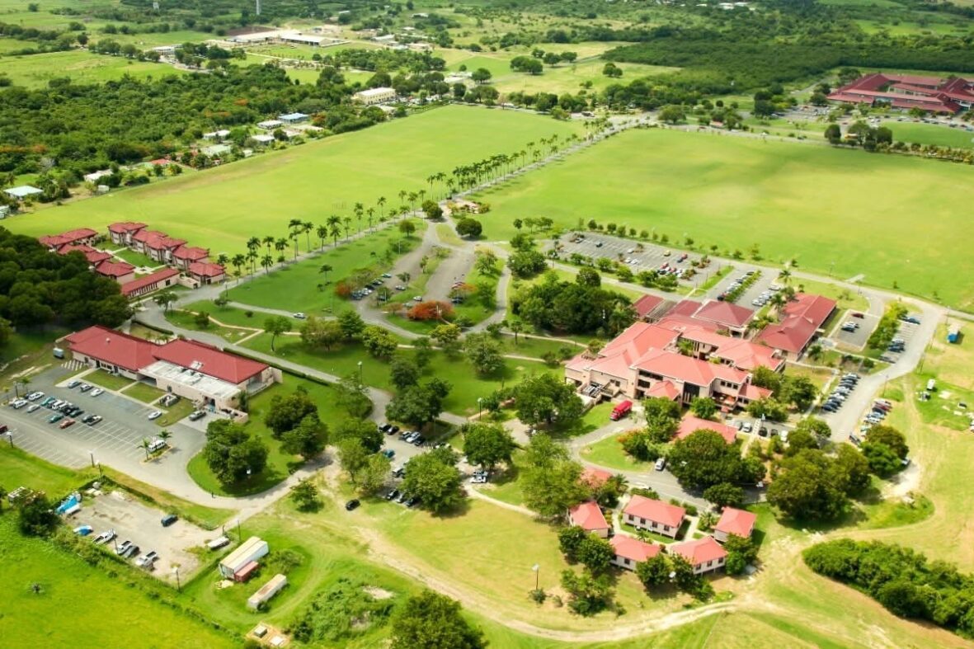
Slide Heading – STX campus background
Body Text – Adjust line spacing and text size based on the amount of content inserted here. Body Text – Adjust line spacing and text size based on the amount of content inserted here.
Body Text – Adjust line spacing and text size based on the amount of content inserted here.
Body Text – Adjust line spacing and text size based on the amount of content inserted here.
Body Text – Adjust line spacing and text size based on the amount of content inserted here.
Body Text – Adjust line spacing and text size based on the amount of content inserted here.
Body Text – Adjust line spacing and text size based on the amount of content inserted here.
Body Text – Adjust line spacing and text size based on the amount of content inserted here.

Slide 4
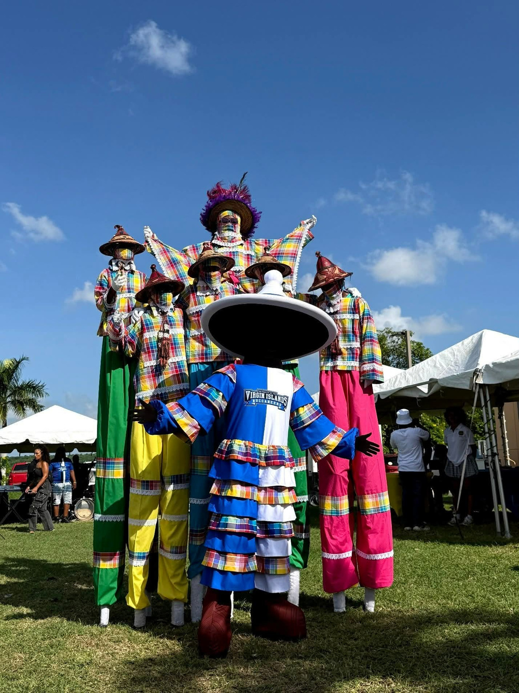
Slide Heading
Body Text – Adjust line spacing and text size based on the amount of content inserted here. Body Text – Adjust line spacing and text size based on the amount of content inserted here.
Body Text – Adjust line spacing and text size based on the amount of content inserted here.
Body Text – Adjust line spacing and text size based on the amount of content inserted here.
Body Text – Adjust line spacing and text size based on the amount of content inserted here.
Body Text – Adjust line spacing and text size based on the amount of content inserted here.
Body Text – Adjust line spacing and text size based on the amount of content inserted here.
Body Text – Adjust line spacing and text size based on the amount of content inserted here.

Slide 5

Slide Heading
Body Text – Adjust line spacing and text size based on the amount of content inserted here. Body Text – Adjust line spacing and text size based on the amount of content inserted here.
Body Text – Adjust line spacing and text size based on the amount of content inserted here.
Body Text – Adjust line spacing and text size based on the amount of content inserted here.
Body Text – Adjust line spacing and text size based on the amount of content inserted here.
Body Text – Adjust line spacing and text size based on the amount of content inserted here.
Body Text – Adjust line spacing and text size based on the amount of content inserted here.
Body Text – Adjust line spacing and text size based on the amount of content inserted here.

Slide 6

Slide Heading
Body Text – Adjust line spacing and text size based on the amount of content inserted here. Body Text – Adjust line spacing and text size based on the amount of content inserted here.
Body Text – Adjust line spacing and text size based on the amount of content inserted here.
Body Text – Adjust line spacing and text size based on the amount of content inserted here.
Body Text – Adjust line spacing and text size based on the amount of content inserted here.
Body Text – Adjust line spacing and text size based on the amount of content inserted here.
Body Text – Adjust line spacing and text size based on the amount of content inserted here.
Body Text – Adjust line spacing and text size based on the amount of content inserted here.

Slide 7

Slide Heading
Body Text – Adjust line spacing and text size based on the amount of content inserted here. Body Text – Adjust line spacing and text size based on the amount of content inserted here.
Body Text – Adjust line spacing and text size based on the amount of content inserted here.
Body Text – Adjust line spacing and text size based on the amount of content inserted here.
Body Text – Adjust line spacing and text size based on the amount of content inserted here.
Body Text – Adjust line spacing and text size based on the amount of content inserted here.
Body Text – Adjust line spacing and text size based on the amount of content inserted here.
Body Text – Adjust line spacing and text size based on the amount of content inserted here.

Slide 8
Slide Heading
Wide text field clean slide
Wide text field clean slide
Wide text field clean slide

Slide 9

Thank you

